Slide 1
Agents that keep track of the world
The simple reflex agent described before will work only if the correct decision can be made on the basis of the current percept.
Tail lights, brake lights, and turn-signal lights, and it is not always possible to tell if the car is braking.
Thus, even for the simple braking rule, our driver will have to maintain some sort of internal state in order to choose an action i.e. it needs the previous frame from the camera to detect when two red lights at the edge of the vehicle go on or off simultaneously.

Slide 2
Example: From time to time, the driver looks in the rear-view mirror to check on the locations of nearby vehicles. When the driver is not looking in the mirror, the vehicles in the next lane are invisible (i.e., the states in which they are present and absent are indistinguishable); but in order to decide on a lane-change maneuver, the driver needs to know whether or not they are there.
The problem arises because the sensors do not provide access to the complete state of the world
In such cases, the agent may need to maintain some internal state information in order to take actions are appropriate in the two states.

Slide 3
Updating internal state information requires two kinds of knowledge to be encoded in the agent program.
First, information about how the world evolves independently of the agent. (Example- an overtaking car generally will be closer behind than it was a moment ago.)
Second, information about how the agent's own actions affect the world. (Example: when the agent changes lanes to the right, there is a gap in the lane it was in before.)

Slide 4
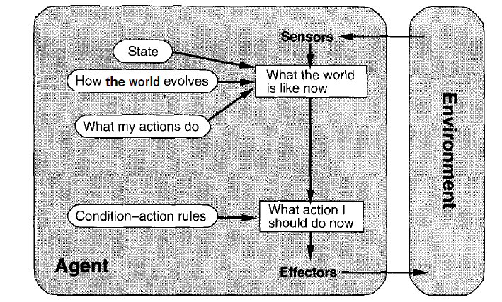

Slide 5
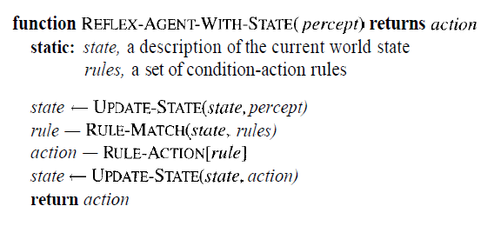

Slide 6
Reflex agent with internal state works by finding a rule whose condition matches the current situation (as defined by the percept and the stored internal state) and then doing the action associated with that rule.

Slide 7
Goal-based agents
Knowing about the current state of the environment is not always enough to decide what to do.
For example, at a road junction, the taxi can turn left, right, or go straight on. The right decision depends on where the taxi is trying to get to.
In other words, as well as a current state description, the agent needs some sort of goal information, which describes situations that are desirable.

Slide 8
Decision-making of Goal-based agents is fundamentally different from the condition-action rules (Reflex agent )
This involves consideration of the future—both "What will happen if I do such-and-such?" and "Will that make me happy?“
Example-1: The reflex agent brakes when it sees brake lights. A goal-based agent, in principle, could reason that if the car in front has its brake lights on, it will slow down.
Example-2: If it starts to rain, the agent can update its knowledge of how effectively its brakes will operate; this will automatically cause all of the relevant behaviors to be altered to suit the new conditions.

Slide 9
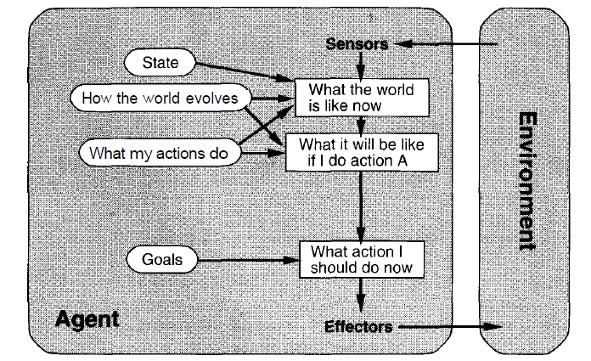
An agent with explicit goals.

Slide 10
Utility-based agents
Goals alone are not really enough to generate high-quality behavior.
For example, there are many action sequences that will get the taxi to its destination, thereby achieving the goal, but some are quicker, safer, more reliable, or cheaper than others.
Goals just provide a crude distinction between "happy" and "unhappy" states, whereas a more general performance measure should allow a comparison of different world states (or sequences of states) according to exactly how happy they would make the agent if they could be achieved.

Slide 11
Because "happy" does not sound very scientific, the customary terminology is to say utility for the agent.
Utility is a function that maps a state onto a real number, which describes the associated degree of happiness.

Slide 12
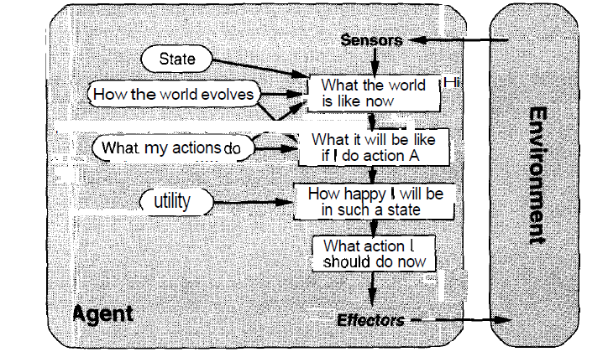

Slide 13
ENVIRONMENTS
Actions are done by the agent on the environment, which in turn provides percepts to the agent.
Properties of environments
Accessible vs. inaccessible.
If an agent's sensory apparatus gives it access to the complete state of the environment, then we say that the environment is accessible to that agent. Sensors should be able to detect all aspects that are relevant to the choice of action.
Deterministic vs. nondeterministic
If the next state of the environment is completely determined by the current state and the actions selected by the agents, then we say the environment is deterministic.

Slide 14
Episodic vs. nonepisodic
In an episodic environment, the agent's experience is divided into "episodes." Each episode consists of the agent perceiving and then acting.
Static vs. dynamic
If the environment can change while an agent is deliberating, then we say the environment is dynamic for that agent; otherwise it is static.
Discrete vs. continuous.
If there are a limited number of distinct, clearly defined percepts and actions we say that the environment is discrete. Chess is discrete—there are a fixed number of possible moves on each turn. Taxi driving is continuous—the speed and location of the taxi and the other vehicles sweep through a range of continuous values.

Slide 15
Environment programs
Simulator: machine designed to provide a realistic imitation of the controls and operation of a vehicle, aircraft, or other complex system, used for training purposes.
The simulator takes one or more agents as input and give each agent the right percepts and receive back an action.
The simulator then updates the environment based on the actions.
Therefore, the environment is defined by the initial state and the update function.

Slide 16
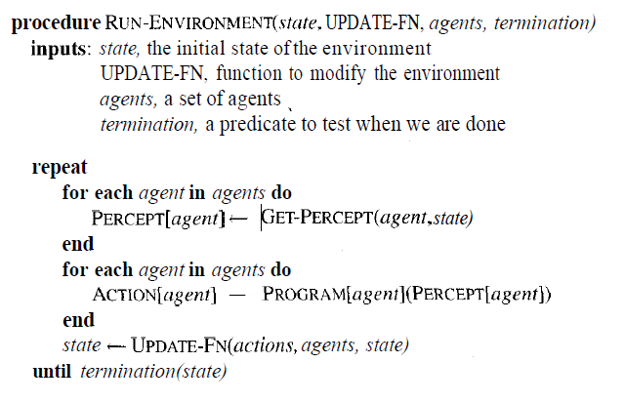
The basic environment simulator program.

Slide 17
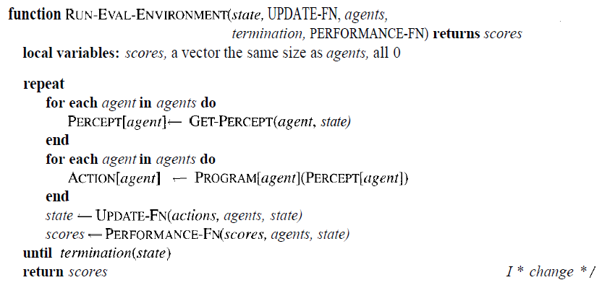
An environment simulator program that keeps track of the performance measure for each agent.

